Slide 1
Streaming Audio

Slide 2


Collect
Data
Preprocess
Data
Design a
Model
Train a
Model
Evaluate
Optimize
Convert
Model
Deploy
Model
Make
Inferences
Micro
Notes:
We are now moving to designing a model!

Slide 3
Collect
Data
Preprocess
Data
Design a
Model
Train a
Model
Evaluate
Optimize
Convert
Model
Deploy
Model
Make
Inferences
Micro
Notes:
We are now moving to designing a model!

Slide 4

Single Shot v. Streaming
Notes:
There are two main ways we can analyze the keyword spotting system --- with single shot testing or with a streaming test

Slide 5
Single Shot v. Streaming
Okay, Google!
Hello, World!
Notes:
By a single shot test we mean to test the model’s accuracy when given a single word. Of course we repeat this test many times and this is the test accuracy you get after training your model!

Slide 6
Single Shot v. Streaming
Hello, world! It is a very nice day to be taking a course and okay, Google! Turn up the volume, now back to the course!
Notes:
Streaming accuracy, on the other hand, is testing the model in a more realistic real-world setting with a long audio file that includes many key words and many non-keywords
Talk about how therefore model training well doesn’t neccesarily mean it works well in the real world! An important thing to consider!

Slide 7
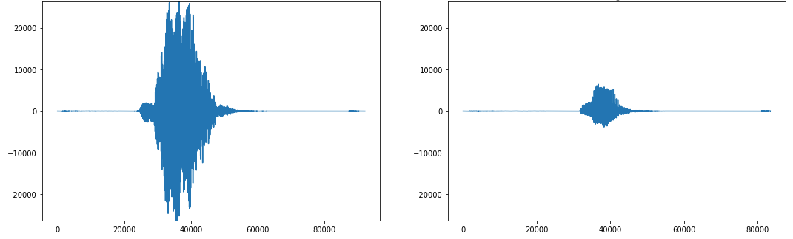
“No” (spoken loudly)
“No” (spoken quietly)

Slide 8
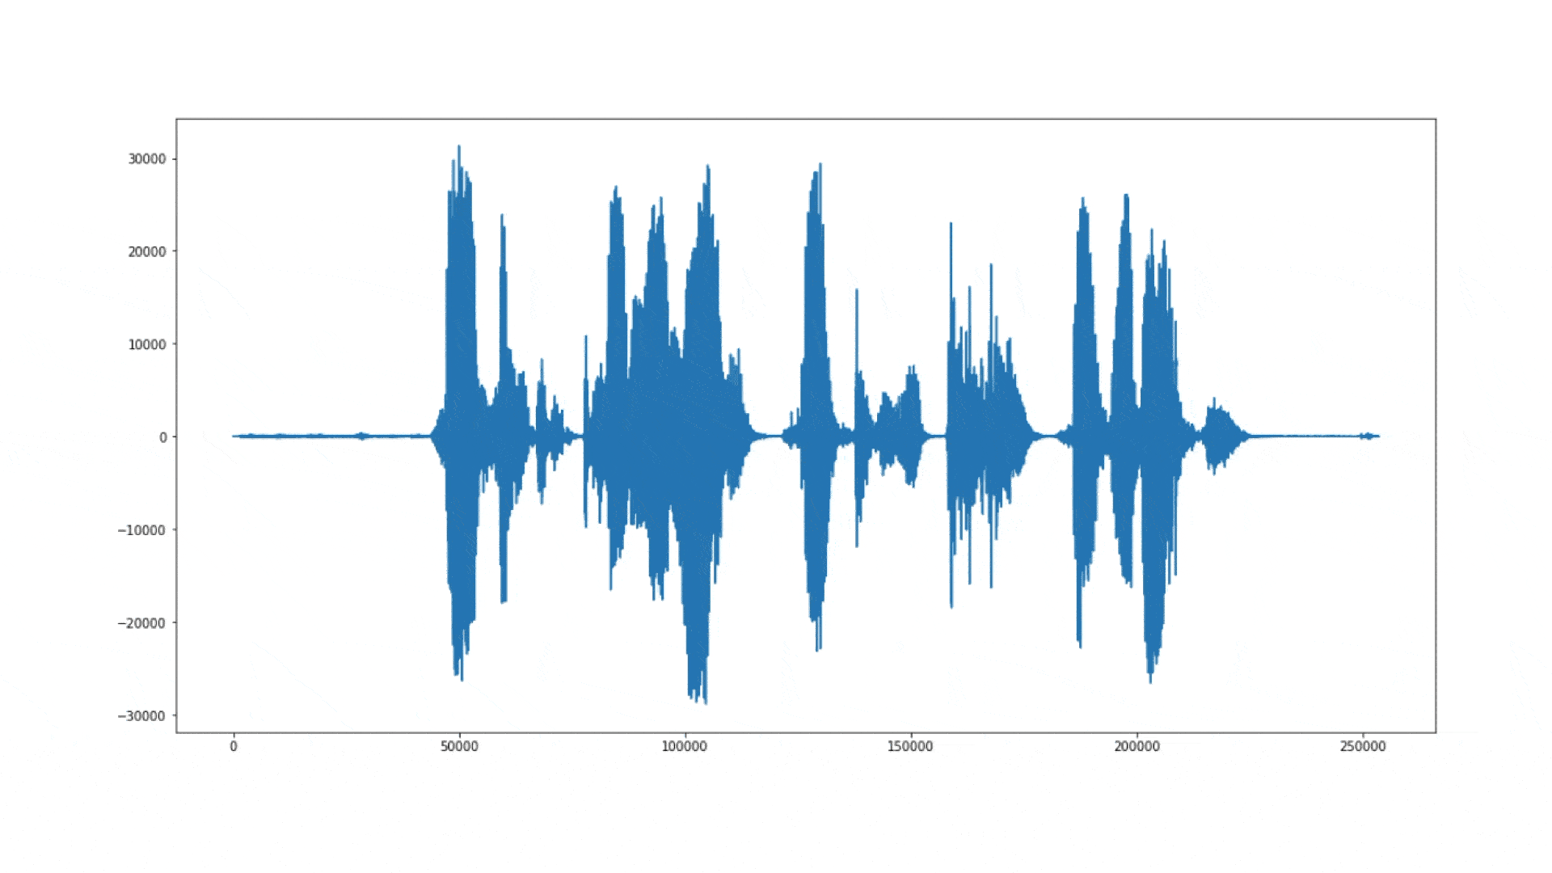
Classifier → Streaming Audio
Notes:
We’ll talk about this more in the next course. So far you know how to build a classifier model that runs on small 1-second snippets of audio, but how can you run it on a continuous stream of audio?
Run the model on sliding windows because we don’t know where the words starts and ends so we need to do all these overlaps to catch it -- this is sort of continuously solving the alignment problem

Slide 9
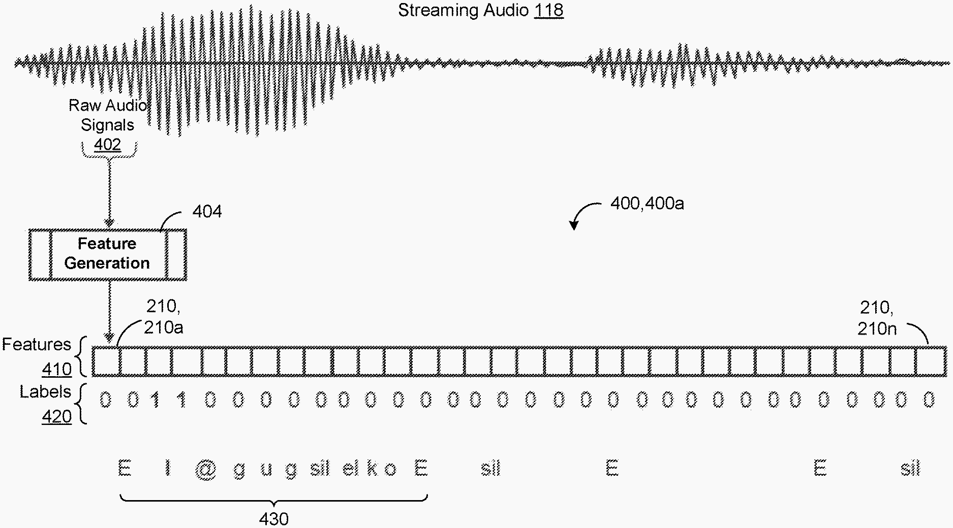
Notes:
https://uspto.report/patent/app/20200126537/US20200126537A1-20200423-D00000.png

